Slide 1
Chapter 2
The Recording Process

Slide 2
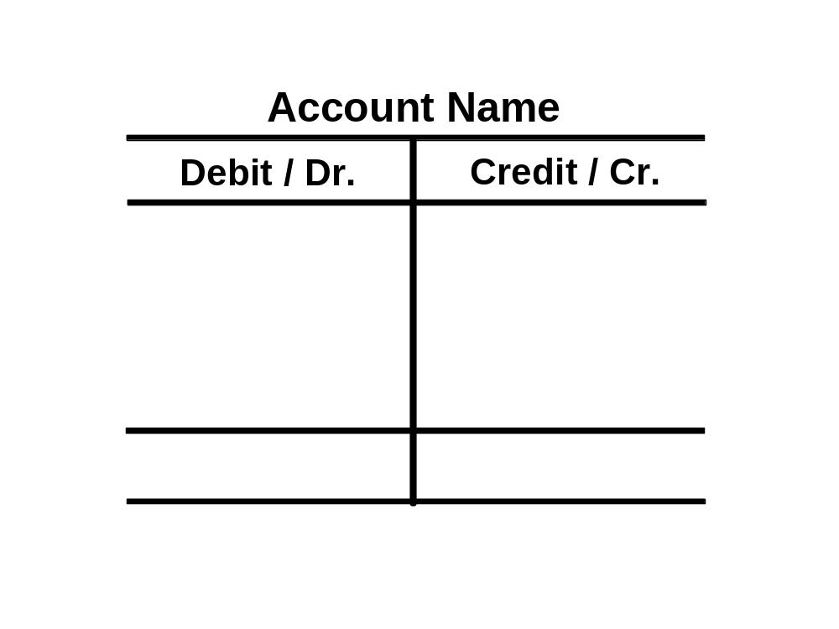

The Account
An account is an individual accounting record of increases and decreases in a specific asset, liability, equity, revenue, or expense item.
Debit = “Left”
Credit = “Right”
Account
An Account can be illustrated in a T-Account form.
SO 1 Explain what an account is and how it helps in the recording process.

Slide 3
Debits and Credits
Debit: A debit is an accounting entry that either increase an asset or expenses account, or decrease a liability or equity account. It is positioned to the left in an accounting entry.
Credit: A credit is an accounting entry that either increase a liability or equity account, or decrease an asset or expense account. It is positioned to the right in an accounting entry.

Slide 4
Debits and Credits
Double-entry accounting system
Each transaction must affect two or more accounts to keep the basic accounting equation in balance.
Recording done by debiting at least one account and crediting another.
DEBITS must equal CREDITS.
SO 2 Define debits and credits and explain their use in recording business transactions.

Slide 5

Debits and Credits
If Debits are greater than Credits, the account will have a debit balance.
Transaction #1
$10,000
$3,000
Transaction #2
Transaction #3
8,000
Balance
$15,000
SO 2 Define debits and credits and explain their use in recording business transactions.

Slide 6
Debits and Credits
If Credits are greater than Debits, the account will have a credit balance.
Transaction #1
$10,000
$3,000
Transaction #2
8,000
Transaction #3
Balance
$1,000
SO 2 Define debits and credits and explain their use in recording business transactions.

Slide 7

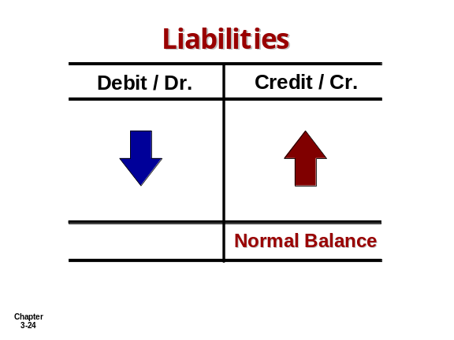
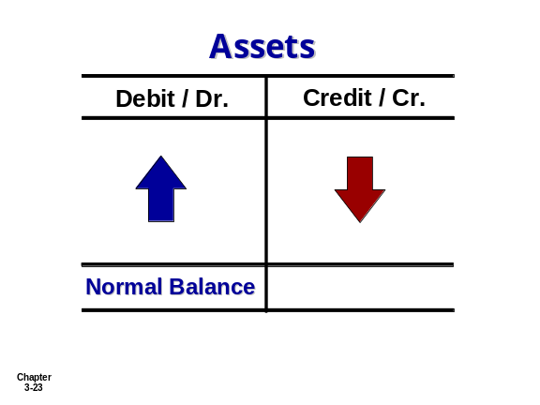
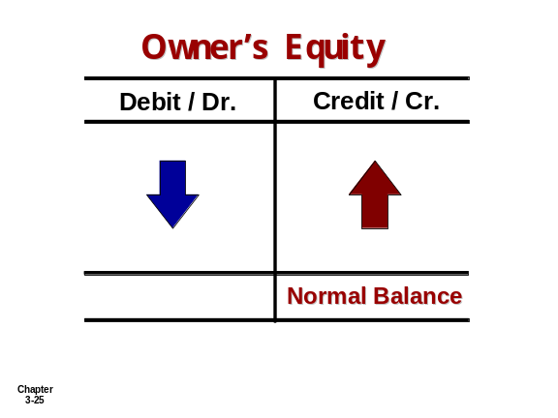
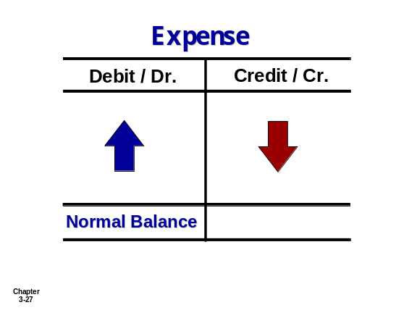
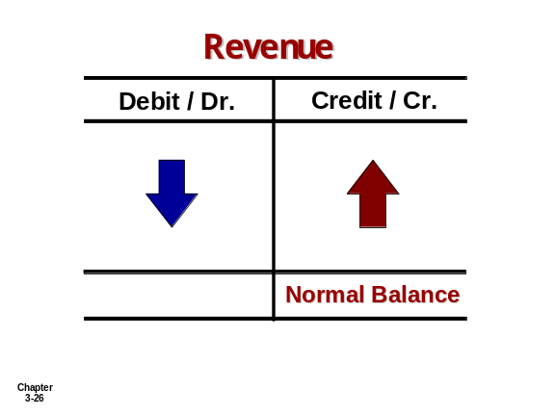
Debits and Credits Summary
Normal Balance Debit
Normal Balance Credit
SO 2

Slide 8


Debits and Credits Summary
Balance Sheet Income Statement
Asset
Liability
+
-
=
Equity
Revenue
Expense
Debit
Credit
SO 2 Define debits and credits and explain their use in recording business transactions.

Slide 9
Assets and Liabilities
Assets - Debits should exceed credits.
Liabilities – Credits should exceed debits.
The normal balance is on the increase side.
SO 2 Define debits and credits and explain their use in recording business transactions.

Slide 10
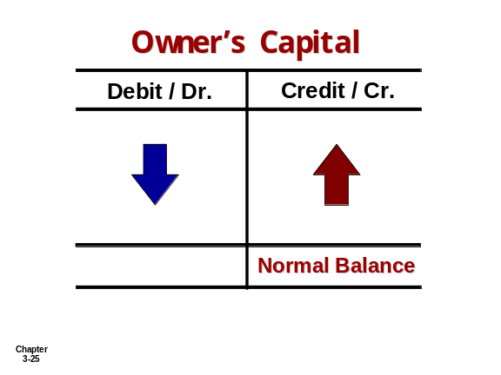
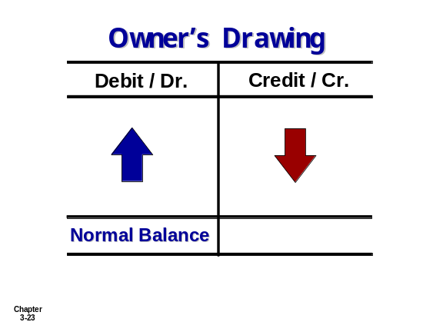
Owners’ Equity
Owner’s investments and revenues increase owner’s equity (credit).
Owner’s drawings and expenses decrease owner’s equity (debit).
SO 2 Define debits and credits and explain their use in recording business transactions.

Slide 11
Revenue and Expense
The purpose of earning revenues is to benefit the owner(s).
The effect of debits and credits on revenue accounts is the same as their effect on Owner’s Capital.
Expenses have the opposite effect: expenses decrease owner’s equity.
SO 2 Define debits and credits and explain their use in recording business transactions.

Slide 12
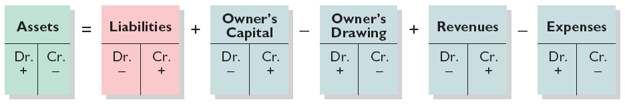
Expansion of the Basic Equation
Relationship among the assets, liabilities and owner’s equity of a business:
Basic Equation
Illustration 2-11
Assets
=
Liabilities
+
Owner’s Equity
Expanded Basic Equation
The equation must be in balance after every transaction. For every Debit there must be a Credit.
SO 2 Define debits and credits and explain their use in recording business transactions.

Slide 13
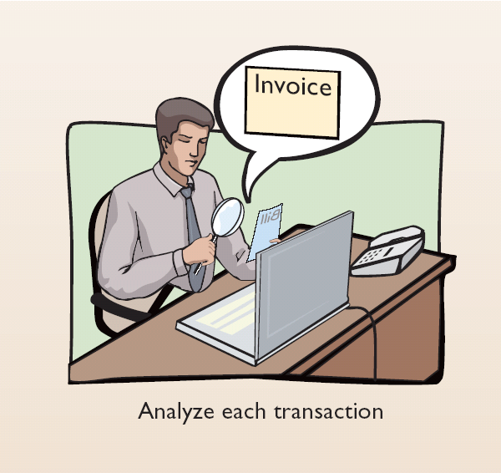
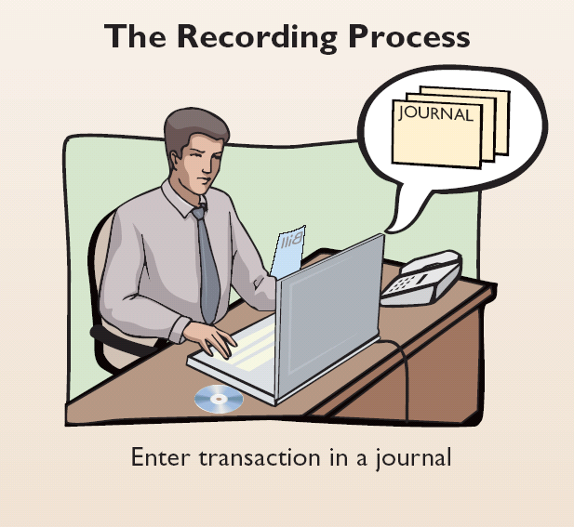
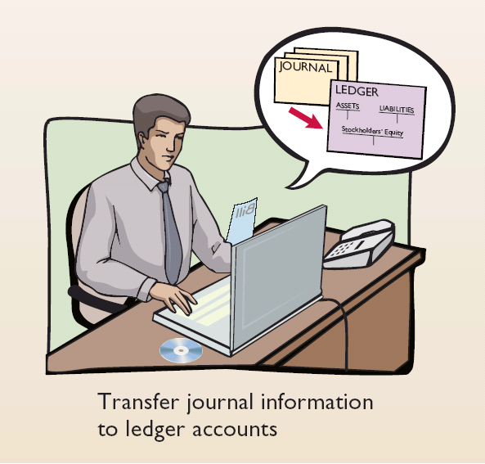
Steps in the Recording Process
Illustration 2-12
Analyze each transaction
Enter transaction in a journal
Transfer journal information to ledger accounts
Business documents, such as a sales slip, a check, a bill, or a cash register tape, provide evidence of the transaction.
SO 3 Identify the basic steps in the recording process.

Slide 14
The Journal
A journal is defined as the book of original entry. The journal shows the debit and credit effect for each transaction. Transactions are initially recorded in chronological order in a journal.
Contributions to the recording process:
  Discloses the complete effects of a transaction.
  Provides a chronological record of transactions.
  Helps to prevent or locate errors because the debit and credit amounts can be easily compared.
SO 4 Explain what a journal is and how it helps in the recording process.

Slide 15
Journalizing
Journalizing - Entering transaction data in the journal.
E2-4 (Facts) Presented below is information related to Hanshew Real Estate Agency.
Oct. 1
Pete Hanshew begins business as a real estate agent with a cash investment of $15,000.
3
Purchases office furniture for $1,900, on account.
6
Bills for B. Kidman $3,200 for realty services provided.
27
Pays $700 on balance related to transaction of Oct. 3.
30
Pays the administrative assistant $2,500 salary for Oct.
E2-5 Instructions - Journalize the transactions for E2-4.
SO 4 Explain what a journal is and how it helps in the recording process.

Slide 16
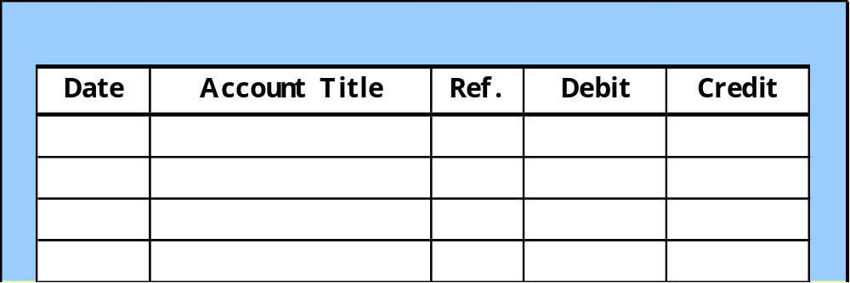
Journalizing
E2-5 (Facts) Journalize the transactions related to Hanshew Real Estate Agency.
Oct. 1
Pete Hanshew begins business as a real estate agent with a cash investment of $15,000.
General Journal
Oct. 1
Cash
15,000
  Hanshew, capital
15,000
(Owner’s investment)
SO 4 Explain what a journal is and how it helps in the recording process.

Slide 17
Journalizing
E2-5 (Facts) Journalize the transactions related to Hanshew Real Estate Agency.
Oct. 3
Purchases office furniture for $1,900, on account.
General Journal
Oct. 3
Office furniture
1,900
  Accounts payable
1,900
(Purchase on account)
SO 4 Explain what a journal is and how it helps in the recording process.

Slide 18
Journalizing
E2-5 (Facts) Journalize the transactions related to Hanshew Real Estate Agency.
Oct. 6
Sells a house and lot for B. Kidman; bills B. Kidman $3,200 for realty services provided.
General Journal
Oct. 6
Accounts receivable
3,200
  Service revenue
3,200
(Services provided)
SO 4 Explain what a journal is and how it helps in the recording process.

Slide 19
Journalizing
E2-5 (Facts) Journalize the transactions related to Hanshew Real Estate Agency.
Oct. 27
Pays $700 on balance related to transaction of Oct. 3.
General Journal
Oct. 27
Accounts payable
700
  Cash
700
(Payment on account)
SO 4 Explain what a journal is and how it helps in the recording process.

Slide 20
Journalizing
E2-5 (Facts) Journalize the transactions related to Hanshew Real Estate Agency.
Oct. 30
Pays the administrative assistant $2,500 salary for Oct.
General Journal
Oct. 30
Salaries expense
2,500
  Cash
2,500
(Payment for salaries)
SO 4 Explain what a journal is and how it helps in the recording process.

Slide 21
Journalizing
Simple Entry – Two accounts, one debit and one credit.
Compound Entry – Three or more accounts.
Example – On June 15, H. Burns, purchased equipment for $15,000 by paying cash of $10,000 and the balance on account (to be paid within 30 days).
General Journal
Jun. 15
Equipment
15,000
  Cash
10,000
  Accounts payable
5,000
(Purchase equipment)
SO 4 Explain what a journal is and how it helps in the recording process.

Slide 22
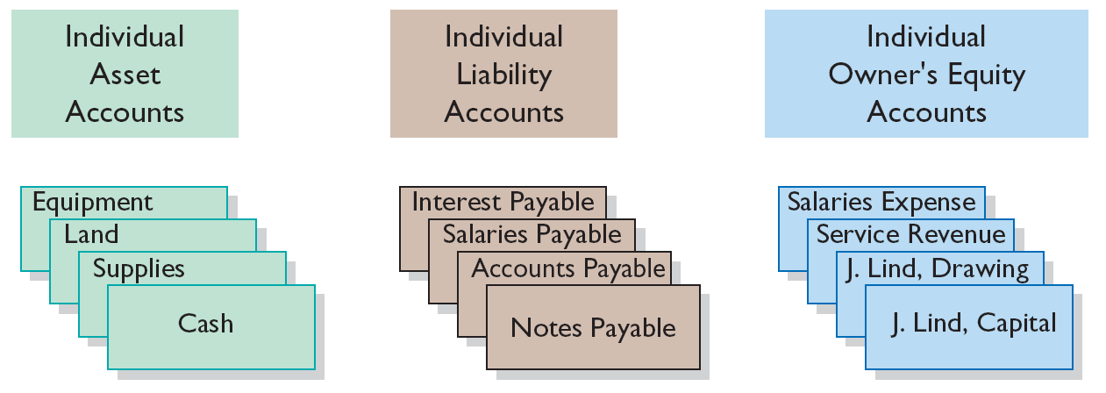
The Ledger
A General Ledger is a complete record of financial transactions. It is a book in which the monetary transactions of a business are posted in the form of debit and credit.
The General Ledger includes all the asset, liability, owner’s equity, revenue and expense accounts.
Illustration 2-15
SO 5 Explain what a ledger is and how it helps in the recording process.

Slide 23
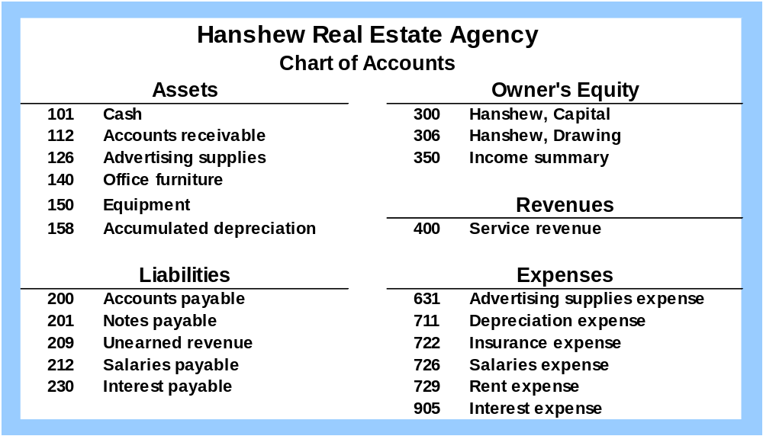
Chart of Accounts
Accounts and account numbers arranged in sequence in which they are presented in the financial statements.
SO 6 Explain what posting is and how it helps in the recording process.

Slide 24
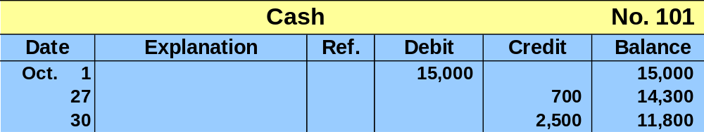
Standard Form of Account
T-account form used in accounting textbooks.
In practice, the account forms used in ledgers are
much more structured.
SO 5 Explain what a ledger is and how it helps in the recording process.

Slide 25
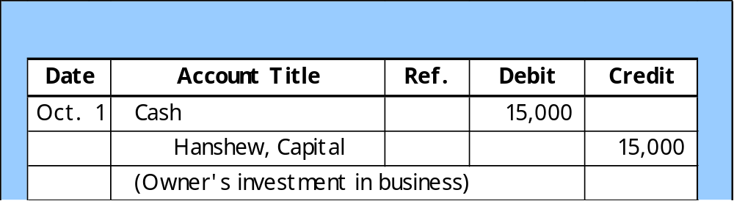
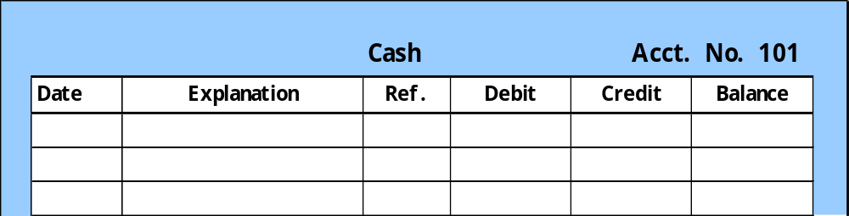
Posting
Posting – the process of transferring amounts from the journal to the ledger accounts.
General Journal
J1
101
General Ledger
Oct. 1
J1
15,000
15,000
SO 6 Explain what posting is and how it helps in the recording process.

Slide 26
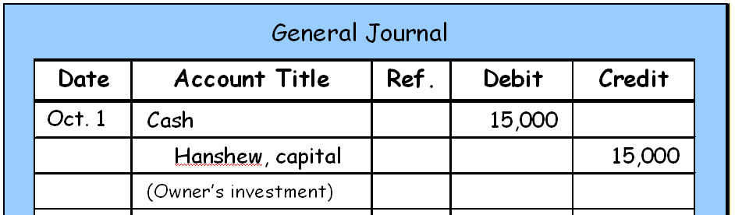
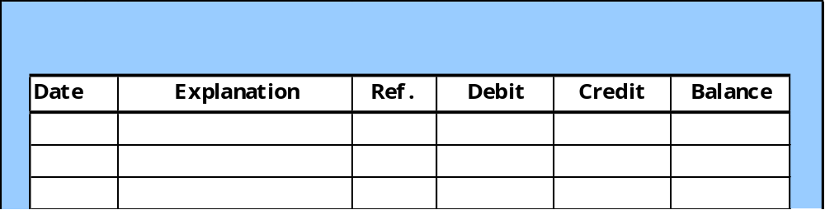
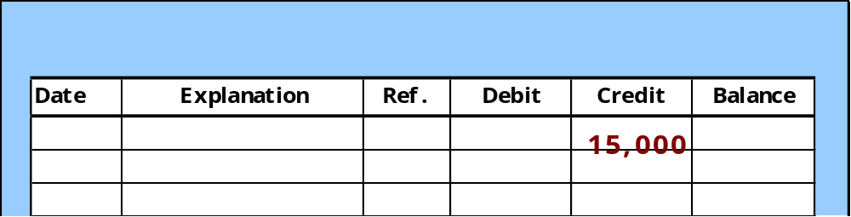
J1
Posting
101
E2-5
300
General Ledger
Cash
Acct. No. 101
Oct. 1
J1
15,000
15,000
General Ledger
Hanshew, capital
Acct. No. 300
Oct. 1
J1
15,000
SO 6 Explain what posting is and how it helps in the recording process.

Slide 27
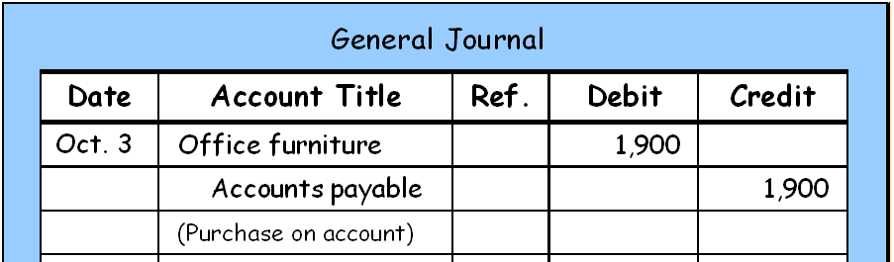
Posting
J1
140
E2-5
200
General Ledger
Office Furniture
Acct. No. 140
Oct. 3
J1
1,900
1,900
General Ledger
Accounts Payable
Acct. No. 200
Oct. 3
J1
1,900
1,900
SO 6 Explain what posting is and how it helps in the recording process.

Slide 28
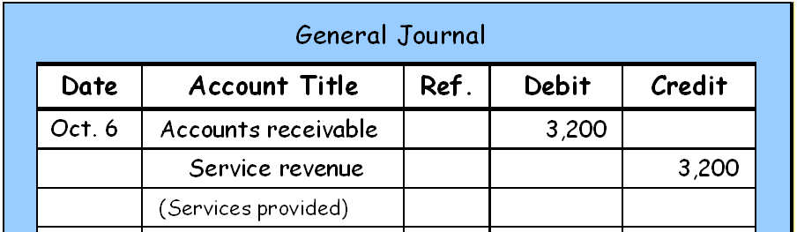
J1
Posting
112
E2-5
400
General Ledger
Accounts Receivable
Acct. No. 112
Oct. 6
J1
3,200
3,200
General Ledger
Service Revenue
Acct. No. 400
Oct. 6
J1
3,200
3,200
SO 6 Explain what posting is and how it helps in the recording process.

Slide 29
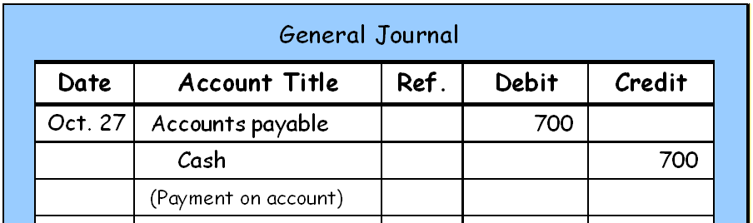
J1
Posting
200
E2-5
101
General Ledger
Cash
Acct. No. 101
Oct. 1
J1
15,000
15,000
Oct.27
J1
700
14,300
General Ledger
Accounts Payable
Acct. No. 200
Oct. 3
J1
1,900
1,900
Oct.27
J1
700
1,200
SO 6 Explain what posting is and how it helps in the recording process.

Slide 30
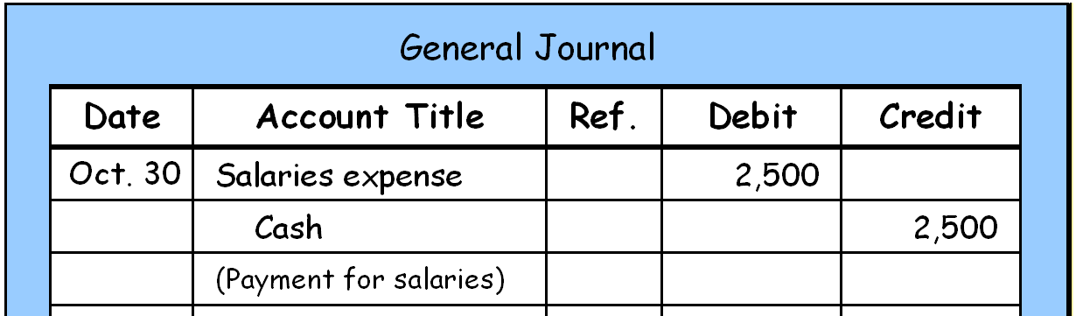
J1
Posting
726
E2-5
101
General Ledger
Cash
Acct. No. 101
Oct. 1
J1
15,000
15,000
Oct.27
J1
700
14,300
Oct.30
J1
2,500
11,800
General Ledger
Salaries Expense
Acct. No. 726
Oct.30
J1
2,500
2,500
SO 6 Explain what posting is and how it helps in the recording process.

Slide 31
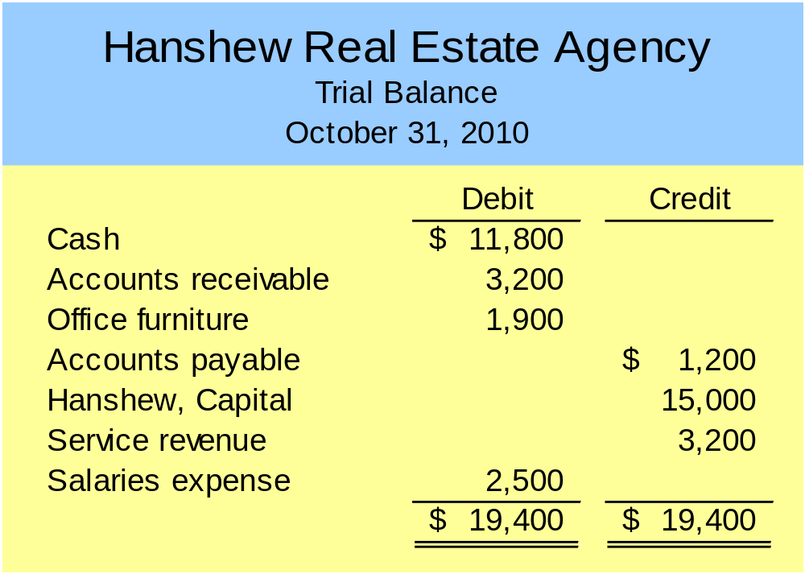
The Trial Balance
A trial balance is a list of debit and credit balances in each account of General Ledger.
Purpose is to prove that debits equal credits.
E2-5
LO 7 Prepare a trial balance and explain its purposes.

Slide 32
The Trial Balance
Limitations of a Trial Balance
The trial balance may balance even when
  a transaction is not journalized,
  a correct journal entry is not posted,
  a journal entry is posted twice,
  incorrect accounts are used in journalizing or posting, or
  offsetting errors are made in recording the amount of a transaction.
LO 7 Prepare a trial balance and explain its purposes.

